Slide 1
Crosscode Customer Interaction Management Suite (CIMS)
Submitted by:
Crosscode Technologies Pvt. Ltd.,
Email – arindam@crosscode.in
Call - +91.99169.65415
A complete call center & CTI suite for hosted & on-premise implementation of contact center operations.
© This document contains confidential and proprietary information of Crosscode Technologies Pvt. Ltd (CTPL). It is furnished for evaluation purposes only. Except with the express prior written permission of CTPL, this document and the information contained herein may not be published, disclosed, or used for any other purpose.

Slide 2
Crosscode timeline
2012
Founded in Nov, 2012.
Focus – customer interaction & process automation.
Products – CIMS, CrossX – contact center & telecom solutions
Domains – retail, healthcare, banking, automotive.
2014
Govt of Karnataka signs up Crosscode.
Dept. Of AHVS implements Crosscode CIMS for state wide helpline.
Products – CommTRACK, CLM Platform Automotive
Domains added – Utility services, Telecom.
2017
Sign-ups with Mercedes Benz, GTL, TCL. Zeiss
National helpdesk of entire Mercedes customer base on our platform.
GTL puts 33,000 towers incident tracking with dialer on Crosscode
Platform hosted as a Cloud Service.
2019
Election Commission 1950 on Crosscode platform
Crosscode provides the tech platform for the Election Commission helpline for Parliament Elections 2019 for entire state of Karnataka.
Bespoke application development on Python for a major DRDO project.

Slide 3
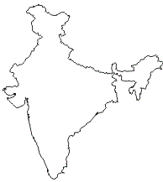
The story so far...
Mission critical solutions*, 200+ installations.
*Call centers, e-Governance, Complaint Tracking, Process Automation, Remote Asset Monitoring, Mobility Solutions.

Slide 4
Crosscode – Domains serviced
BPO
Retail
Health Care
Utilities
OEM
Telco
IT SI
Crosscode
BFSI

Slide 5
Crosscode call center platform – implement your ideas
Crosscode CIMS Platform – helping you bridge the gap between the idea & the implementation

Slide 6
Component composition of the platform
Modular architecture allows plugging in of components as & when needed, without production stoppages…
CROSSCODE CIMS Platform
Voice logger
Dialer
Manager Tools
CRM Adapter
IVRS
Multi-media
Phone – call, SMS
Email
Web
Mobile apps
Phone banking
CSAT
Self-service
DTMF / Speech
SAP
Salesforce
Siebel
Oracle Forms, in-house
Preview
Predictive
Manual
Blaster

Slide 7
Platform highlights
Supports In-bound, Out-bound & blended operations. | Built-in QA tool for voice recording, playback and download.
Highly scalable architecture and resource efficient | Intelligent & highly configurable campaign, DNC, churn, re-try management tools.
Highly available system, with in-built fail-over mechanism. | Real-time dashboard for channel status, trunk availability, agent activity, queue status, campaign penetration.
Supports predictive / preview / auto-preview / blaster (OBD) / manual dialing modes. | Exhaustive & customizable set of reports on agent performance, lead penetration, dialer performance.
Supervisor can barge-in, coach, monitor, change agent ready / not ready, etc non-intrusively and on-demand. | Intelligent and configurable call back feature & queue management for inbound operations.
Can integrate with enterprise platforms like SAP, Siebel, SalesForce, Remedy, Oracle apps. | Customizable MOH.
Supports connection to E1/T1/PRI, SS7, SIP, H323, POTS, GSM trunks. | IVRS with ACD capabilities defined as per business requirements.
CallDesk Agent Desktop comes with “WYSIWYG” user-friendliness & inbuilt soft-phone. | Can integrate with any legacy PBX or channel bank to connect analog extensions.

Slide 8
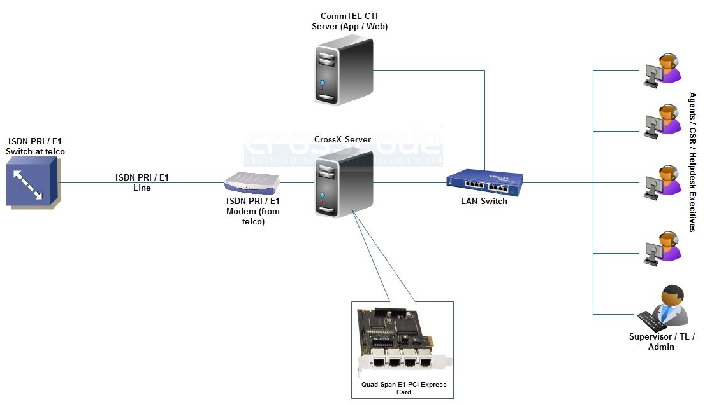
Platform implementation layout – using ISDN PRI

Slide 9
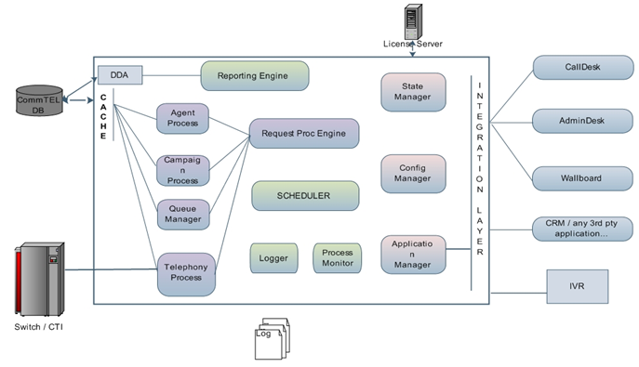
Platform architecture

Slide 10
Server sizing & requirements
Server – 2 nos for 30 seats (indicative specs)
CPU | Intel Xeon Quad Core
RAM | 8GB
HDD | 500GB (will vary with logging requirements)
PCI Express slots | 1
OS | CentOS
DVD RW Drive | 1

Slide 11
Why Crosscode?
CommTEL is a proven business enabler, delivering an edge to our clients…
Capabilities
Support & Services
Commercial model
Crosscode Edge

Slide 12
Support & Services Edge
Fast & effective - being a completely in-house built call center platform, the team is completely in control of the platform and every member knows the platform in its complete technical detail. Hence any support request gets identified and resolved effectively and fast.
Single point of contact - a phone call to our support desk is the only thing you need to do when you need us and the resolution will also be provided that support desk only. We don't have any dependencies with regards to CommTEL on any other 3rd party and hence your service requests get responded to and complied with, without any mailing loops or long drawn multi-party conference calls.
Single point of responsibility - we own full responsibility of the CommTEL platform implementation that we undertake for you, the buck stops with us. So you don't have to waste time with us in convincing us that you need support on CommTEL. If its an issue with regards to CommTEL, we resolve it with full ownership.
Problem solving approach - from the initial requirement gathering, solution propositioning to the implementation and support, our interactions with your teams will always be with a problem solving approach. We will always come back to you with the most economically & technically viable solution.
Extended team - we will assist your technical / IT / system admin team to resolve issues with your telecom operators.

Slide 13
Capabilities Edge
Cross platform experience - we bring with us an in-depth and exhaustive understanding and experience of most of the major platforms in the call center market, namely Avaya, Cisco, Genesys, Aspect, etc.
Telecom integration - we have done implementations where complex integrations are required with existing legacy devices, which helps the client to re-use investments already made. For example we have had integrations with Avaya, Cisco, Ericsson, Siemens, Nortel PBX systems which has allowed our clients to continue using their existing telecom infrastructure without any stoppage or loss or waste of resources or time.
Application integration - we have designed, developed & deployed complex application integrations with enterprise wide CRM or ERP systems which could be Java applets based (Oracle Forms) or Client based (Talisma) or any Web based system. Notable systems integrated are SAP, SalesForce, Talisma, Oracle Forms, Oracle BRMS to name a few.
Productivity consultation - we can assist your operations or business team to identify ways and means of extracting maximum productivity out of the call center's resources - agents, channels, platform..

Slide 14
Commercial Model Edge
Managed service model - this is a long term and very tightly coupled mode of engagement where we provide our technology, services and support as an extended team of the client
Payment model – monthly rental on a "per seat per month" model
Contract – both parties sign the CommTEL Managed Services Contract for a period of 3 years, subsequently renewable on a yearly basis
Implementation – implementation commences upon the signing of the contract and the payment of the applicable implementation charges.
Support – support & services on the platform are part of the engagement and are not charged separately.
Change requests – changes on the platform will be accommodated within the cost. But any new feature development will be scoped & charged separately.
Purchase model - this is a one time buy-out model where the client pays for a determined number of seats
Payment model – this is a one time purchase model where the client has to pay 50% of the order value with the Purchase Order and rest upon completion of implementation. There will be no dependency on go-live or signoff from the client side.
Purchase Order – the client needs to issue a Purchase order to Crosscode with complete commercial & deliverable details.
Implementation – implementation commences upon receipt of the PO and the payment.
Support – support & services on the platform are covered under an AMC @ 20% of the current implementation value. This AMC amount is payable yearly in advance.
Change requests – any development effort for a change or new feature will be scoped & charged separately.

Slide 15
The Crosscode Edge
A summary of the benefits you accrue as a client, owing to the Crosscode Edge
A technology that molds itself to your current and future requirements in terms of capabilities, features, scale & reliability.
A commercial model that is true and mitigates the risk of a substantial financial investment.
A team that has the necessary expertise and experience on the implemented platform and the call center domain to provide solutions that are effective and productive

Slide 16
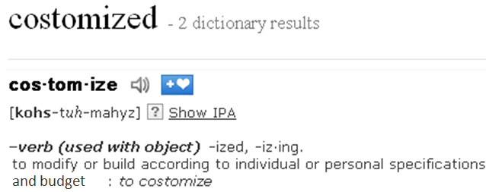
Welcome to the world of costomized* enterprise solutions
*

Slide 17
thanking you…
Crosscode Technologies Pvt. Ltd.,
No 478, 2nd Floor, 1st Main Road,
Anand Nagar,
Bangalore – 560024, India
W: www.crosscode.in

Slide 18
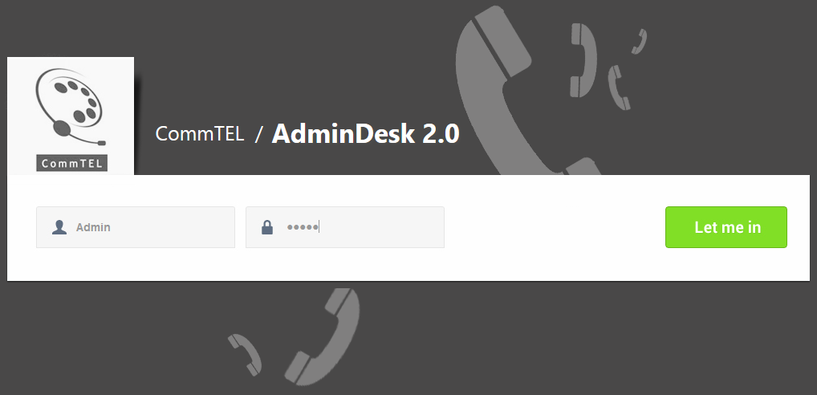
CallDesk & AdminDesk Logins
Agent login steps
Admin login

Slide 19
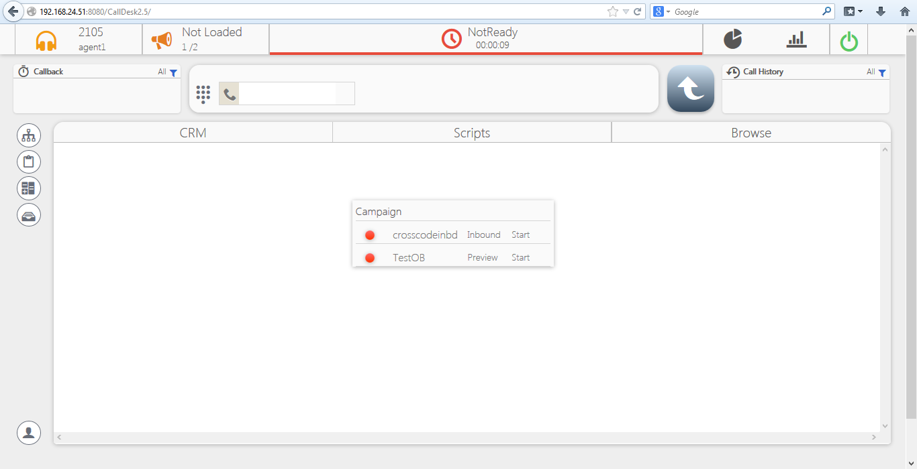
Agent page post login
CallDesk – ALL in ONE unified Agent Desktop
Call handling
Call Disposition
CRM

Slide 20
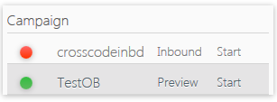
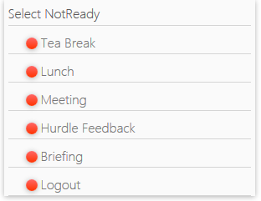
CallDesk – Campaign selection, breaks
Shows the campaigns to which the agent is assigned. Select the campaign needed & proceed.
Shows the agent is ready to take or make calls. Also the time for which he / she is ready
Shows the campaign selected
Manual dial either type in the number or click on the dial pad
Green means – click to dial out
In order to go from Ready to Not Ready state → Click on the Ready tab → Select No Ready reason.

Slide 21
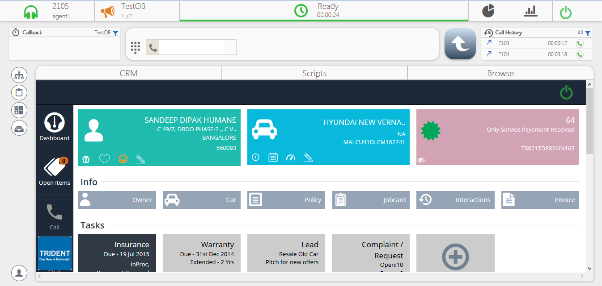
Single window CRM with customer data

Slide 22
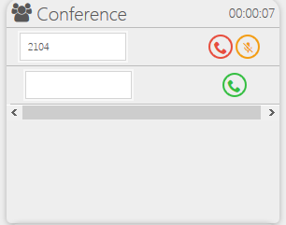
Active call – Transfer, conference
Shows Active or In call state with time duration of call.
Start a n-party conference, just type in the number and click dial. Keep adding as many participants as needed.
Transfer – Warm Transfer – Conference -- Hold
Red button – click to disconnect call / hang up.
Disconnect or mute/unmute participants as required. Add participant by clicking on Dial button.
Transfer a call → Type in the number → Click to dial

Slide 23
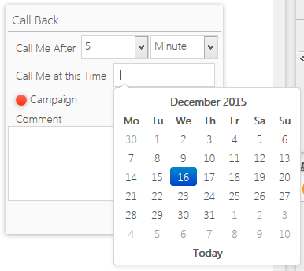
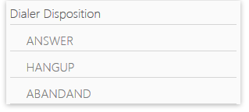
After call work, call back functions
Call back configuration – either do it relative from now – 5 mins from now or select a specific date & time.
Post call disconnect the agent is in After Call Work (ACW) mode. Also known as wrap up mode. Orange colour button means ACW
To close the call & get Ready again, select the disposition. Dispositions are campaign specific
Call history shows number of calls dialed or received or missed for the session

Slide 24
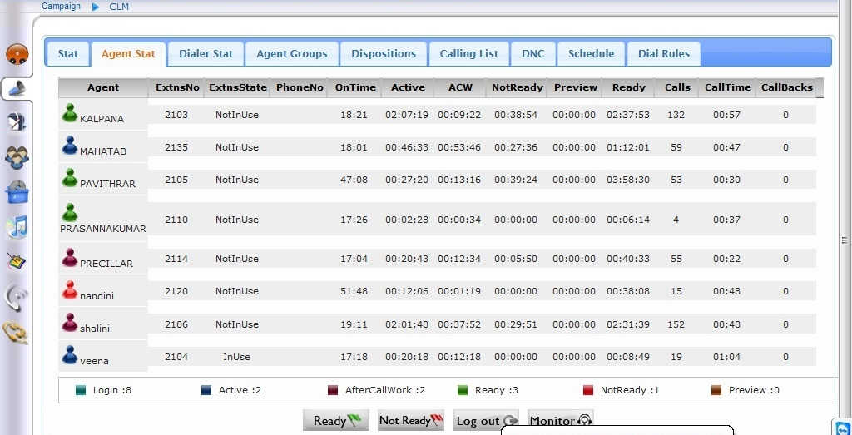
AdminDesk Real Time Agent Monitoring

Slide 25
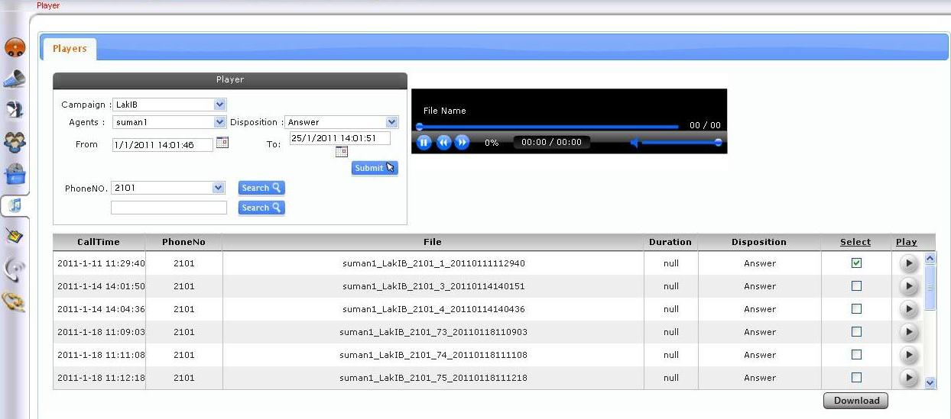
AdminDesk QA + Voice Log Player

Slide 26
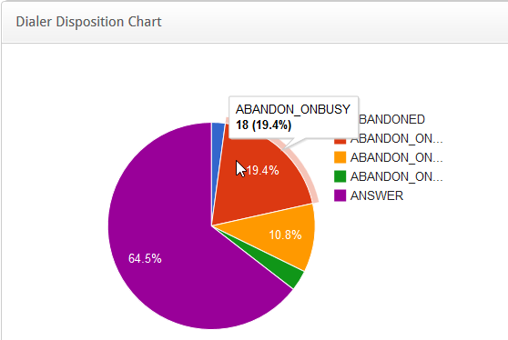
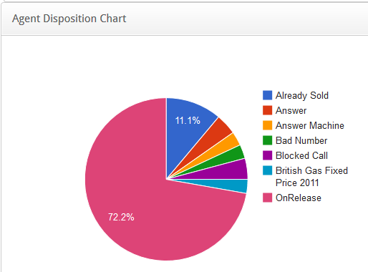
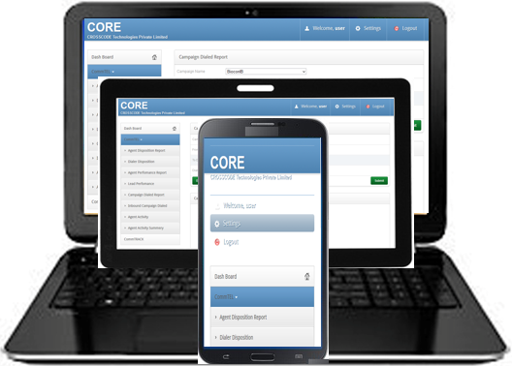
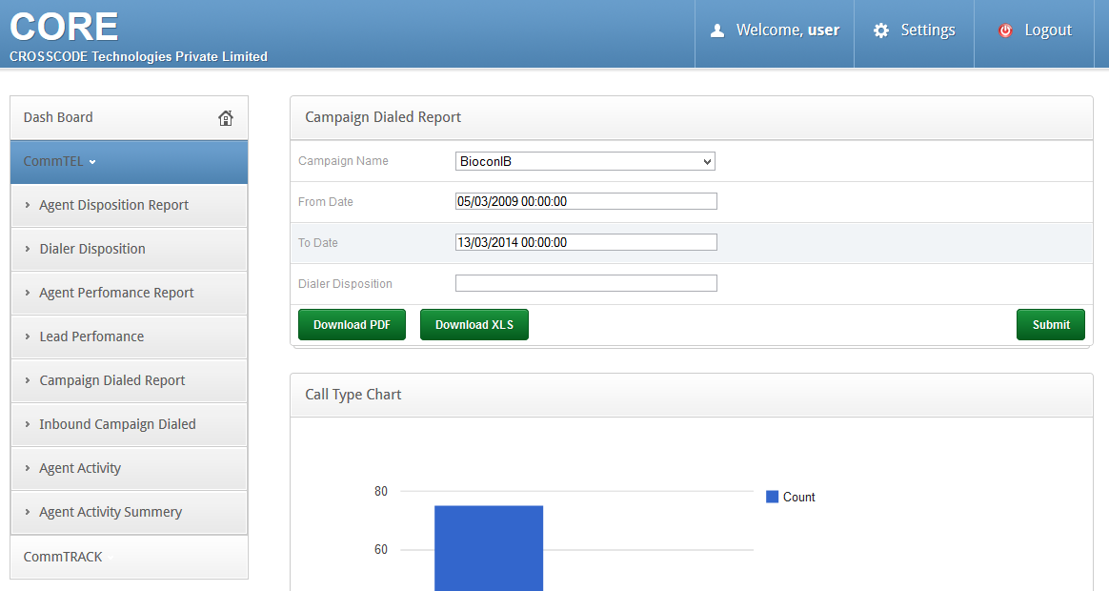
CORE Unified Reporting Tool
CORE can be accessed across devices – PC, tab, phones…
Report, charts across applications

Slide 27
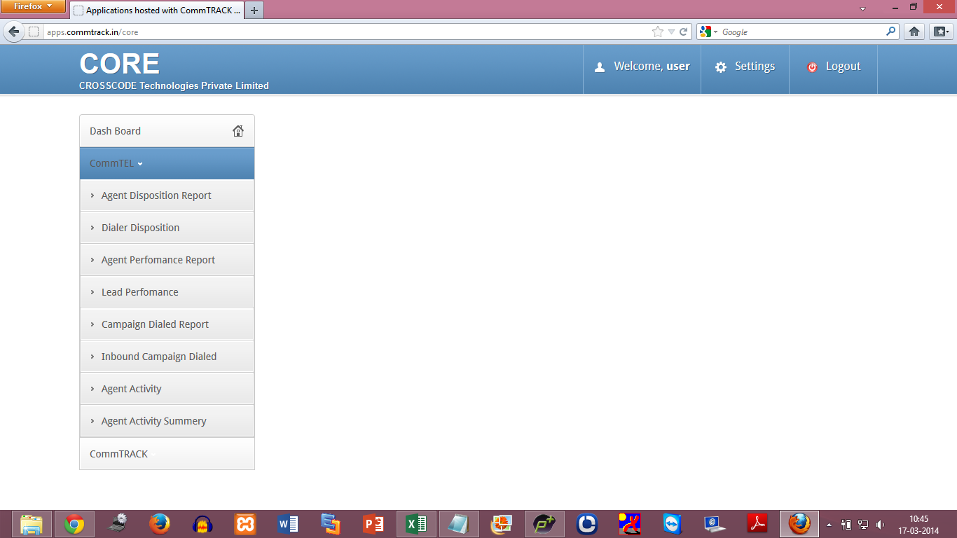
CORE User Home Page
Notice the 2 applications – CommTEL & CommTRACK. Other apps will be listed likewise & you have one interface to access all reports

Slide 28
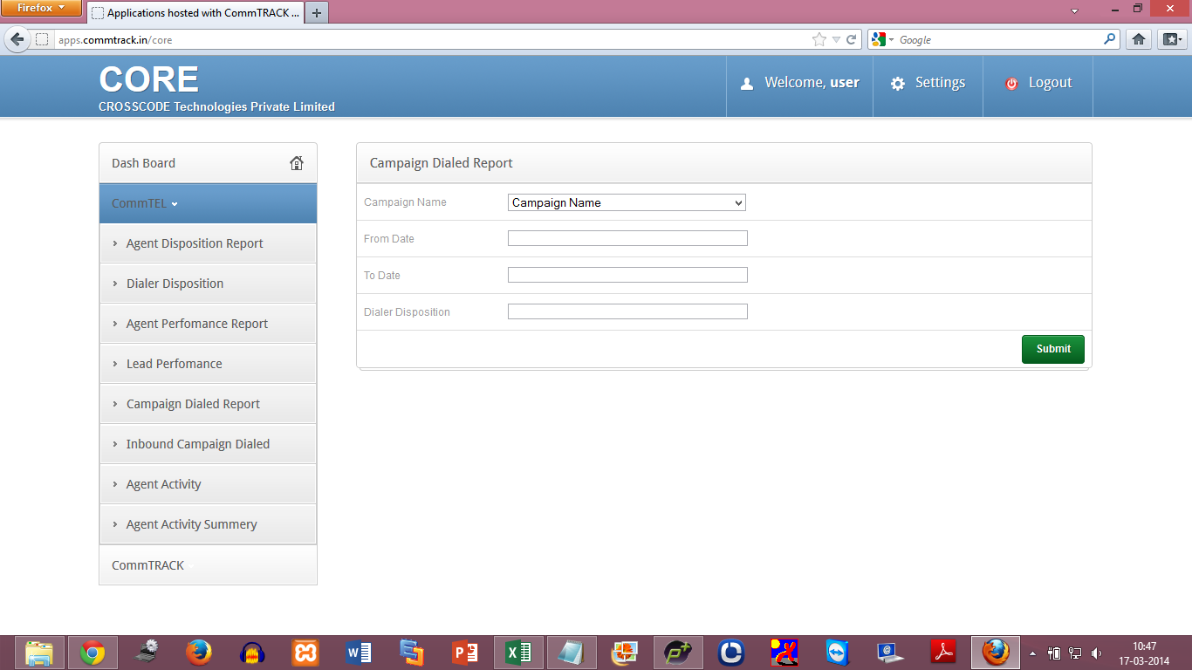
CORE Generate Report
The report selected is Campaign Dialed Report.
The name, date range for the report is filled in…

Slide 29
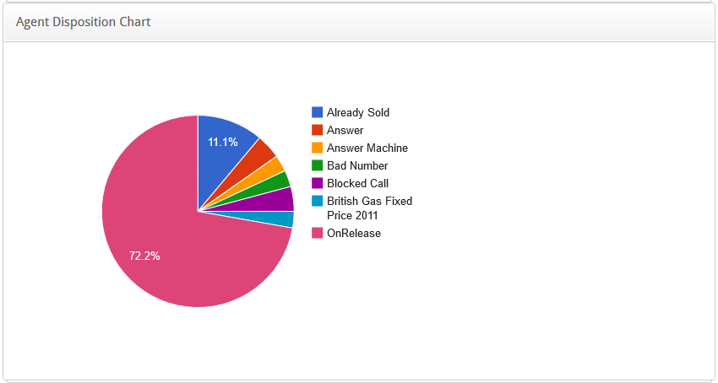
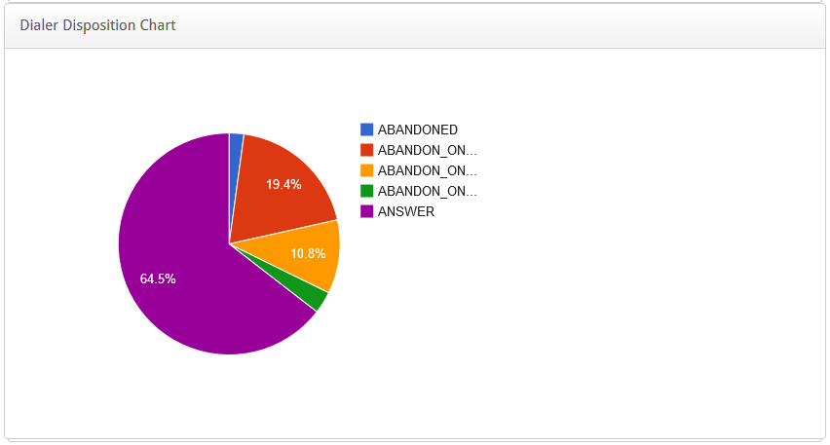
CORE Charts
The Charts are configurable based on requirements
The Charts can be exported as JPG for directly using them in your PPTs.

Slide 30
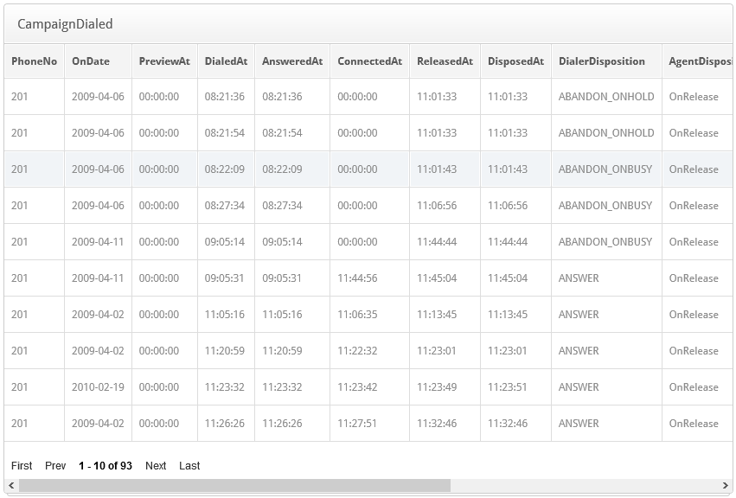
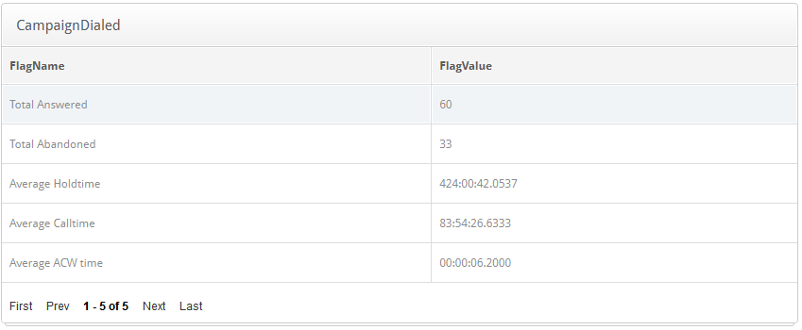
CORE Report View

Slide 31
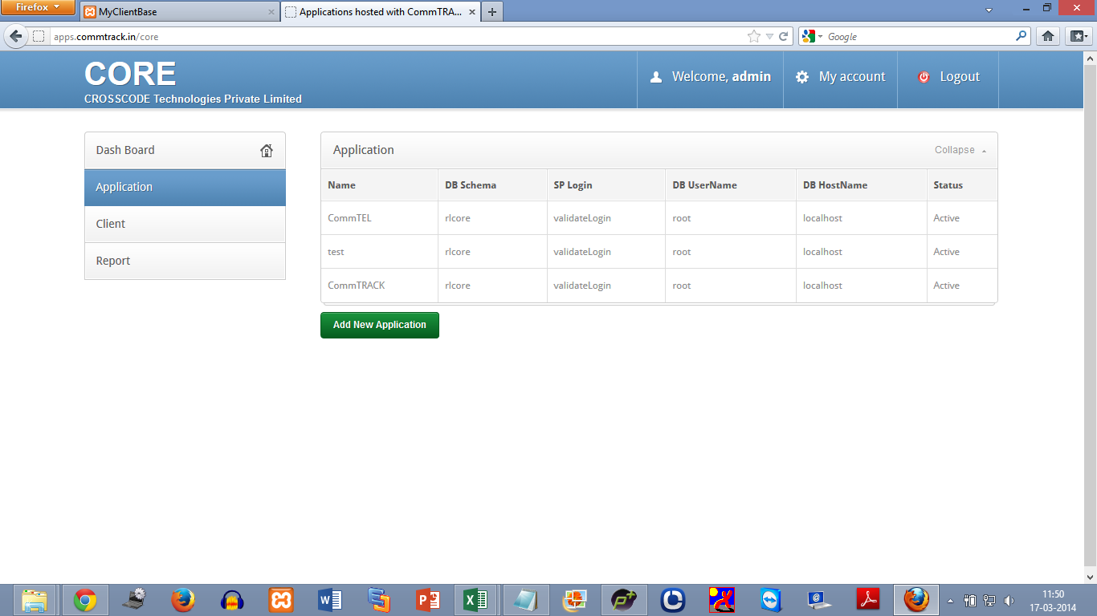
CORE Admin Home Page

Slide 32
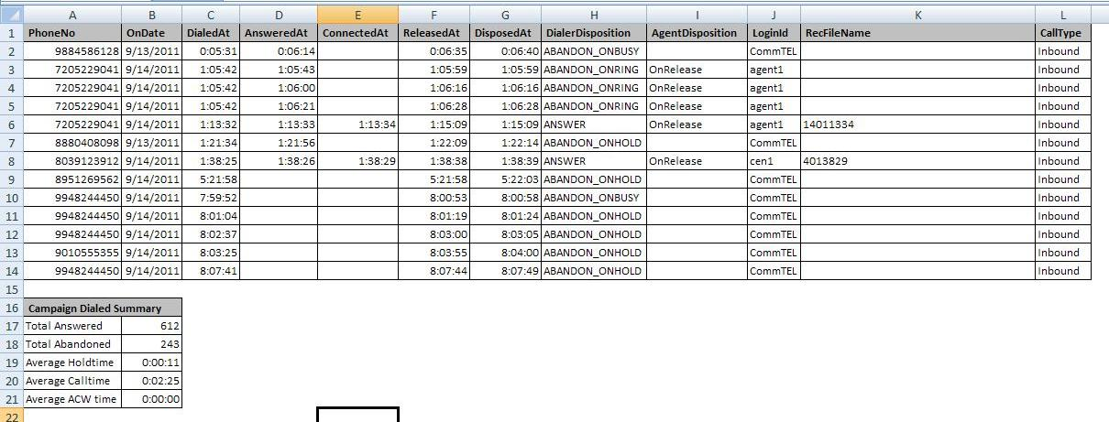
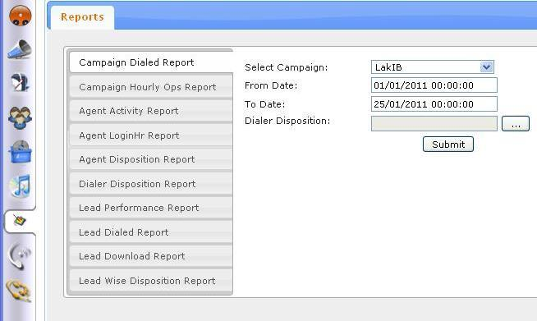
AdminDesk Reporting

Slide 33
Feature list – 1 / 3
ACD
Inbound call queuing
Queue position adherence
Queue time notification
Call distribution
Park state
DID
DNIS routing
ANI Routing
Skills based routing
Agent rank based routing
Circular routing
Longest idle routing
Scheduling of ACD services
Agent access rights control
Call Data definitions
Screen Pop Dialog
Call re-routing based on unmanned service
Call re-routing based on queue length, wait times or service hours
Dynamic priority on longest wait time
Dynamic priority on relative wait time
Dynamic priority on absolute number of calls in Q
Dynamic priority on relative number of calls in Q
Dynamic priority on absolute number of calls
Application startup script launch
ANI Capture
Callback of captured ANIs
Abandoned call list preview & print
Scheduled call back
Whisper message
Call dispositions
ACW & timed ACW
Attention retainers
MOH
Multi-DNIS support
Wait time estimation & Q Optimization
Blended mode
Warm transfer
Accept or deny to receive a call
Language preference
IVR State persistence

Slide 34
Feature list – 2 / 3
Outbound modes
Modes
Automatic
Preview
Predictive
Blaster
Precision
Manual
Campaign modes can be interchanged dynamically
Outbound features
Attach data
Manual dialing
Skill based routing
Pacing controls
Wait message
NANP manager
Time Zone admin
Machine detection
Multi-numbers for a campaign record
dial order selection
External Database based dialing
Access to external dialing service table
Automated dialing feed
Disposition admin & mgmt
Scheduled callback
Agent callback with dynamic promotion
Expired callback deletion
Call re-routing
Multiple campaigns
Default campaign
Auto-switch of agents
Scheduling of campaigns
Call routing
Call rerouting
Caller name configuration
Warm transfer
Quota control
Redial Number

Slide 35
Feature list – 3 / 3
Campaign list management
Multiple list per campaign
Dynamic structure of list
Weighted list
Database creation
CRM creation
Churning
DNC management
Global DNC list
Campaign wise DNC list
Agent DNC list
Real-time dashboards
Agent activity
Dialer state
List wise disposition status
CTI
ACD Vendor support
Real-time stats
Transfer to CTI agent / extension
Voicemail
Voice recording
Voice recording
Recording automation
Recording on demand
IVR transaction recording
Screen capture
Web collaboration recording
Recording notification
Recording classification
Media player features
Recording search
Recording export
Recording archival

